Slide 1
Human Computer Interface
ASP.net and Database

Slide 2
DATABASES WITH ASP.NET
Web applications commonly access data sources for storage and retrieval of dynamic data.
You can write code to access data using classes from the System.Data namespace (commonly referred to as ADO.NET) and from the System.Xml namespace.
This approach was common in previous versions of ASP.NET.

Slide 3
However, ASP.NET also enables you to perform data binding declaratively. This requires no code at all for the most common data scenarios, including:
  Selecting and displaying data.
  Sorting, paging data.
  Updating, inserting, and deleting data.
  Filtering data using run-time parameters.
  Creating master-detail scenarios using parameters.

Slide 4
ASP.NET includes several types of server controls that participate in the declarative data binding model, including
  data source controls and
  data-bound controls.

Slide 5
Data Source Controls
Data source controls are ASP.NET controls that manage the tasks of connecting to a data source and reading and writing data.
Data source controls do not render any user interface, but instead act as an intermediary between a particular data store (such as a database, business object, or XML file) and other controls on the ASP.NET Web page.

Slide 6
Data source controls enable rich capabilities for retrieving and modifying data, including
  querying,
  sorting,
  filtering,
  paging,
  updating,
  deleting, and
  inserting.

Slide 7
Data source control
Some of the data source controls are:
AccessDataSource
  Enables you to work with a Microsoft Access database.
SQLDataSource
  Enables you to work with ADO.NET managed data providers, which provide access to Microsoft SQL Server, OLE DB, ODBC, or Oracle databases.
XMLDataSource
  Enables you to work with an XML file.

Slide 8
Data-bound Web Server Controls
You can work with a data-bound control by binding it to a data source control such as a SqlDataSource control.
The data source control connects to a data source such as a database or middle-tier object and then retrieves or updates data. The data-bound control can then use this data.
To perform the binding, you set the data-bound control's DataSourceID property to point to a data source control.
When a data-bound control is bound to a data source control, little or no additional code is required for data operations, because the data-bound control can automatically take advantage of the data services provided by the data source control.

Slide 9
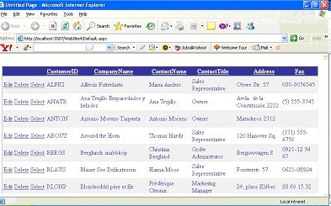
GridView Control
The Grid View control displays data as a table and provides the capability to sort columns, page through data, and edit or delete a single record.

Slide 10
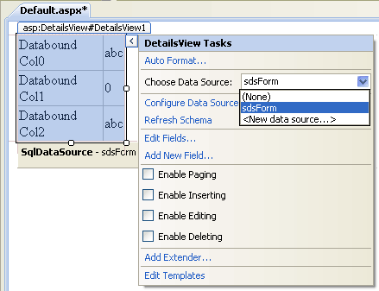
DetailsView Control
The DetailsView control renders a single record at a time as a table and provides the capability to page through multiple records, as well as to insert, update, and delete records.
The DetailsView control is often used in master-detail scenarios where the selected record in a master control such as a GridView control determines the record displayed by the DetailsView control.

Slide 11

FormView Control
The FormView control renders a single record at a time from a data source and provides the capability to page through multiple records, as well as to insert, update, and delete records, similar to the DetailsView control.
However, the difference between the FormView and the DetailsView controls is that the DetailsView control uses a table-based layout where each field of the data record is displayed as a row in the control.
In contrast, the FormView control does not specify a pre-defined layout for displaying a record.

Slide 12
Repeater Control
The Repeater control renders a read-only list from a set of records returned from a data source.
Like the FormView control, the Repeater control does not specify a built-in layout. Instead you create the layout using templates.

Slide 13
DataList Control
The DataList control renders data as table and enables you to display data records in different layouts, such as ordering them in columns or rows.
You can configure the DataList control to enable users to edit or delete a record in the table.

Slide 14
ListView Control
The ListView control displays data from a data source in a format that you define using templates.
The template contains the formatting, controls, and binding expressions that are used to lay out the data.

